Slide 1
Some Fundamental Concepts in Supervised Learning
See Syllabus for reference reading

Slide 2
Maximum Likelihood Estimation (MLE)
Given a parametric model for a set of data, in general, how do you devise a good way to estimate the parameters? i.e., what criterion do you optimize?
MLE is a very general principle on which many parametric model estimators are derived
Many familiar estimators from a first course in statistics turn out to be MLEs
The model fitting criteria in linear and logistic regression can both be derived as applications of MLE; likewise for many supervised learning models
When a researcher proposes a new model for a problem, they usually start with the MLE principle to fit the model
In statistical modeling software, choosing a method of model fitting is often related to choosing a statistical model for which the method of fitting is the corresponding MLE

Slide 3
The MLE Principle
Suppose you have some parametric model to represent your data, with parameters denoted by θ ≡ {θ₁, θ₂, . . ., θ_{p}}, and you want to fit the model (i.e., estimate the parameters) based on a random sample of data Y ≡ {y₁, y₂, . . ., y_{n}}.
Denote the joint distribution of the data by f(y₁, y₂, . . ., y_{n}; θ₁, θ₂, . . ., θ_{p}), or f(Y; θ) for short. We call f(Y; θ):
the prob. distribution, when viewed as a function of Y, for fixed values of θ, or
the likelihood function, when viewed as a function of θ for the fixed values of Y in your actual data sample.
Basic MLE Principle: Take the estimates of θ to be values that maximize the likelihood function f(Y; θ). We call these values the MLE of θ.

Slide 4
Example: Estimating μ and σ for a Normal Pop.
data: Y = {y₁, y₂, . . ., y_{n}} (suppose i.i.d. sample)
model: Y_{i} ~ NID(μ,σ²)
parameters: θ = {μ, σ} (p = 2)
marginal pdf of Y_{i}: f(y_{i}; μ,σ) =
joint pdf of Y₁, . . ., Y_{n} (aka likelihood function):
f(Y; μ,σ) =
What are the MLEs of μ and σ?

Slide 5
Example: Estimating the coefficients in Logistic Regression
data: Y = {y₁, y₂, . . ., y_{n}} (suppose i.i.d. sample)
model: for i = 1, 2, . . ., n, Y_{i} ~ Bernoulli with
where x_{i} = [1, x_{i1}, . . . x_{ik}]^{T} (k predictor variables)
parameters: β = [β₀, β₁, . . ., β_{k}]^{T} (p = k+1)
marginal distribution of Y_{i}: f(y_{i}; β) =
joint distribution of Y₁, . . ., Y_{n}:
f(Y; β) =

Slide 6
Logistic Regression Example (Car Marketing Study)
The data in Car.csv are car purchasing behavior for n = 33 households from a marketing survey. The response is binary (1 if a household purchased a car; 0 otherwise). Household income and age of oldest existing car are two other household variables that were recorded
For the ith household in the survey:
x_{i1} = household income (thousands)
x_{i2} = age of oldest auto
The objective is to model the probability that a household will purchase a new car, as a function of demographic and other available data for the household
Why might such an analysis be useful for marketing purposes?

Slide 7
Model Fitting and Illustration of the Likelihood Function
#######Illustration of car purchase data and likelihood function############
CAR<-read.table("Car.csv",sep=",",header=TRUE)
CAR
glm1 <- glm(y ~ ., family = binomial(link="logit"), data = CAR)
summary(glm1)
p_hat <- predict(glm1, type="response")
data.frame(CAR, p_hat=round(p_hat,3))
attach(CAR); y <- CAR$y
plot(car_age[y==1],income[y==1],col="red", pch=15, xlab="car_age", ylab="income", xlim=c(1,6), ylim=c(10,100))
points(car_age[y==0], income[y==0], col="black", pch=19)
detach(CAR)

Slide 8
> summary(glm1)
Call:
glm(formula = y ~ ., family = binomial(link = "logit"), data = CAR)
Coefficients:
Estimate Std. Error z value Pr(>|z|)
(Intercept) -4.73931 2.10195 -2.255 0.0242 *
income 0.06773 0.02806 2.414 0.0158 *
car_age 0.59863 0.39007 1.535 0.1249
(Dispersion parameter for binomial family taken to be 1)
Null deviance: 44.987 on 32 degrees of freedom
Residual deviance: 36.690 on 30 degrees of freedom
AIC: 42.69
> data.frame(CAR, p_hat=round(p_hat,3))
y income car_age p_hat
1 0 32 3 0.315
2 0 45 2 0.379
3 1 60 2 0.628
4 0 53 1 0.366
5 0 25 4 0.343
6 1 68 1 0.614
7 1 82 2 0.882
8 1 38 5 0.696
9 0 67 2 0.730
10 1 92 2 0.936
11 1 72 3 0.874
12 0 21 5 0.420
13 0 26 3 0.235
14 1 40 4 0.590
15 0 33 3 0.330
16 0 45 1 0.251
17 1 61 2 0.643
18 0 16 3 0.135
19 1 18 4 0.245
20 0 22 6 0.585
21 0 27 3 0.247
22 1 35 3 0.361
23 1 40 3 0.442
24 0 10 4 0.159
25 0 24 3 0.211
26 1 15 4 0.209
27 0 23 3 0.200
28 0 19 5 0.387
29 1 22 2 0.114
30 0 61 2 0.643
31 0 21 3 0.179
32 1 32 5 0.604
33 0 17 1 0.048

Slide 10
Discussion Points and Questions
In the expression for the likelihood function, which rows have a p_{i}, and which have a 1−p_{i}?
Intuitively, why does it make sense to maximize the likelihood function when fitting the model?

Slide 11
Nonlinear Regression Models and Nonlinear Least Squares
A general form of nonlinear regression model is Y_{i} = g(x_{i},θ) + ε_{i}, where:
Y_{i}: response for observation i
x_{i}: vector of predictors for observation i
θ: vector of model parameters
g(x_{i},θ): some parametric nonlinear function
ε_{i}: zero-mean random error for observation i
We will see shortly that if the random errors are Gaussian and independent of x, the MLE of θ is just nonlinear least squares

Slide 12
Example: Manufacturing Learning Curve
Y = relative efficiency of operation
x₂ = week #
If there were only one facility, and the data looked like below, how would you model it?
y
1.0
x₂

Slide 13
Discussion Questions
If facilities A and B had different asymptotic efficiencies as in Fig. 13.5, how would you modify the model?
If facilities A and B had different exponential rates, how would you modify the model?
If the objective was to determine if the two facilities had different asymptotic efficiencies, how could you do this?
Are the formulae for t-tests, standard errors, etc. in a linear regression still valid? If not, how would you calculate and use the analogous quantities in nonlinear regression?

Slide 14
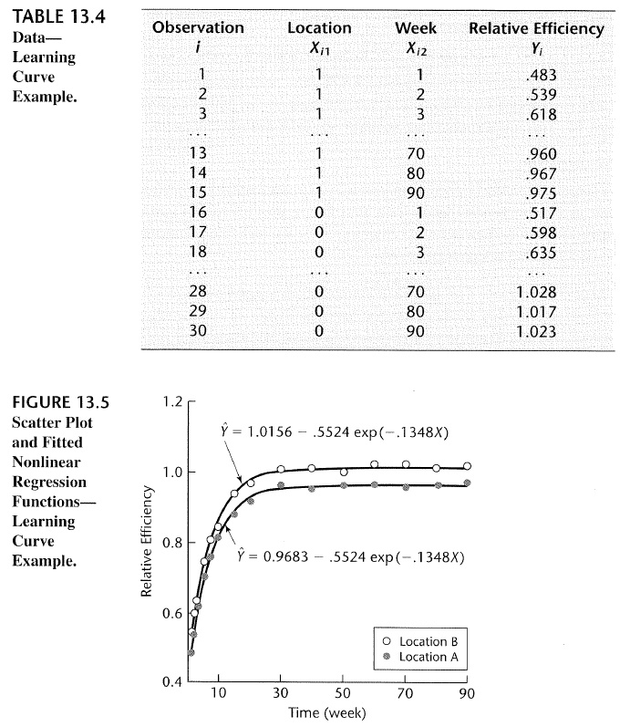

Slide 15
MLE for General Nonlinear Regression Model with Normal Errors
Y_{i} = g(x_{i},θ) + ε_{i}
with error distribution: ε_{i} ~ NID(0,σ²)
view the x_{i}'s as deterministic, not random
write Y_{i} = μ_{i} + ε_{i}
with μ_{i} ≡ g(x_{i},θ) (to simplify notation)
⇒ Y_{i} ~ NID(μ_{i},σ²)
marginal pdf of Y_{i}: f(y_{i}; θ,σ) =
joint pdf of Y₁, . . ., Y_{n} (aka likelihood function):
f(Y; θ,σ) =

Slide 16
MLE of θ: Choose to maximize f(Y; θ,σ)
⇒ i.e., minimize
i.e, the MLE of θ for the general nonlinear regression model with i.i.d. Gaussian errors (that are independent of x) is "nonlinear least squares"
In general, we need optimization software to fit the model

Slide 17
Summary of Steps in General MLE
Write out the form of the statistical model that you are using to represent the data
Find the marginal distribution of each individual observation Y_{i} (for regression problems the x_{i}'s are not treated as random, so you only need to find the marginal distribution of the Y_{i}'s given the x_{i}'s)
From the marginal distributions in step (2), find the joint distribution f(Y; θ) of the entire set of data Y
If tractable, find an analytical expression for the θ that maximizes the likelihood f(Y; θ). Otherwise, use optimization software to minimize −log f(Y; θ)
The MLE of θ is the minimizer in step (4), and the Hessian can be used to assess statistical uncertainty (next topic)

Slide 18
Relevant R Functions and Packages
nlm() – minimize a general nonlinear function, such as implementing MLE for a nonstandard model (but most specific statistical models in R have built-in MLE implementation)
nls() – nonlinear least squares
boot – bootstrapping package
cross-validation is built into many R modeling functions (as an optional argument or as a separate function like cv.tree or cv.glm), or not hard to write your own function

Slide 19
R commands for fitting learning curve example using the general optimizer nlm()
MLC<-read.table("MLC.csv",sep=",",header=TRUE)
x1<-MLC$Location;x2<-MLC$Week;y<-MLC$Efficiency
fn <- function(p) {yhat<-p[1]+p[2]*x1+p[4]*exp(p[3]*x2); sum((y-yhat)^2)}
out<-nlm(fn,p=c(1,0,-.5,-.1),hessian=TRUE)
theta<-out$estimate #parameter estimates
theta
###we will use the following later, for finding SEs and CIs#######
MSE<-out$minimum/(length(y) - length(theta)) #estimate of the error variance
InfoMat<-out$hessian/2/MSE #observed information matrix
CovTheta<-solve(InfoMat)
SE<-sqrt(diag(CovTheta)) #standard errors of parameter estimates
MSE
CovTheta
SE

Slide 20
R commands for fitting learning curve example using the nonlinear LS function nls()
MLC<-read.table("MLC.csv",sep=",",header=TRUE)
x1<-MLC$Location;x2<-MLC$Week;y<-MLC$Efficiency
fn2 <- function(x1,x2,p) p[1]+p[2]*x1+p[4]*exp(p[3]*x2)
out2<-nls(y~fn2(x1,x2,p),start=list(p=c(1,0,-.5,-.3)),trace=TRUE)
summary(out2)

Slide 21
Statistical Uncertainty in Supervised Learning
With nonlinear regression models, the formulae for assessing statistical uncertainty in linear regression (e.g., F-tests and t-tests for significance of predictors, SEs and CIs for parameters, PIs and CIs for new observations, etc.) do not apply directly
Question: Why might we want to calculate SEs, CIs/PIs, do hypothesis tests, etc?
For some nonlinear models, we can use approximate asymptotic analytical results valid for sufficiently large sample size n to assess statistical uncertainty (via Fisher information matrix)
Fortunately, we also have alternative computational approaches that apply to any nonlinear model:
Cross-validation for deciding which models are the best (which implies which terms belong in the model, among other things)
Bootstrap resampling (or bootstrapping for short) for SEs and CIs on the parameters and CIs and PIs on new observations

Slide 22
Overview of Bootstrapping
You are given a sample of data of size n observations.
You have estimated some parameter(s) θ (call it )
Objective: Estimate the sampling distribution of and quantities like SE( ) that are derived from it.
Problem: Hypothetically, if we knew the form of the population distribution, we could consider using simulation to draw many random samples (each of size n) from the population and calculate a different for each sample. We could construct a histogram of all the 's and take their sample standard deviation to be an estimate of SE( ). But what if we do not know the form of the population distribution?

Slide 23
Example: How you could use regular simulation to find the SE of a sample average, if you know the population distribution (for example, normal)
Generate say 10,000 samples, each of size n = 20, from an N(5.3,0.4^2) distribution
Calculate the averages { : j = 1, 2, . . ., 10,000} for the 10,000 replicates
Take

Slide 24
Bootstrapping overview continued
The bootstrap sampling approach: Draw a "bootstrap" sample as a random sample of the same size n from the original sample of n observations (with replacement), and calculate a for the bootstrap sample. Repeat a large number of times, each time drawing another bootstrap sample (of size n) and calculating another for that sample. Then construct a histogram of all the 's, take their sample standard deviation to be an estimate of SE( ), etc.
Why this works: Consider making a pretend population that consists of your original sample of n observations, copied over and over, an infinite number of times. Each bootstrap sample is equivalent to drawing a random sample of size n from this infinite pretend population.

Slide 25
Example: How you could use bootstrapping to find the SE of a sample average, if you do NOT know the population distribution
Generate say 10,000 bootstrap samples, each of size n = 20, from your one real sample
Calculate the averages { : b = 1, 2, . . ., 10,000} for the 10,000 replicates
Take

Slide 26
A Different Example (that has nothing to do with nonlinear regression)
Pop₀ = population of all grains
Pop₁ = population of all grains with thickness < 0.3 and equivalent diameter > 0.6
μ_{R} = mean aspect ratio for all grains in Pop₁
f = = fraction projected area of grains in Pop₁
The patent claim is violated if f > 0.5 AND μ_{R} > 8

Slide 27
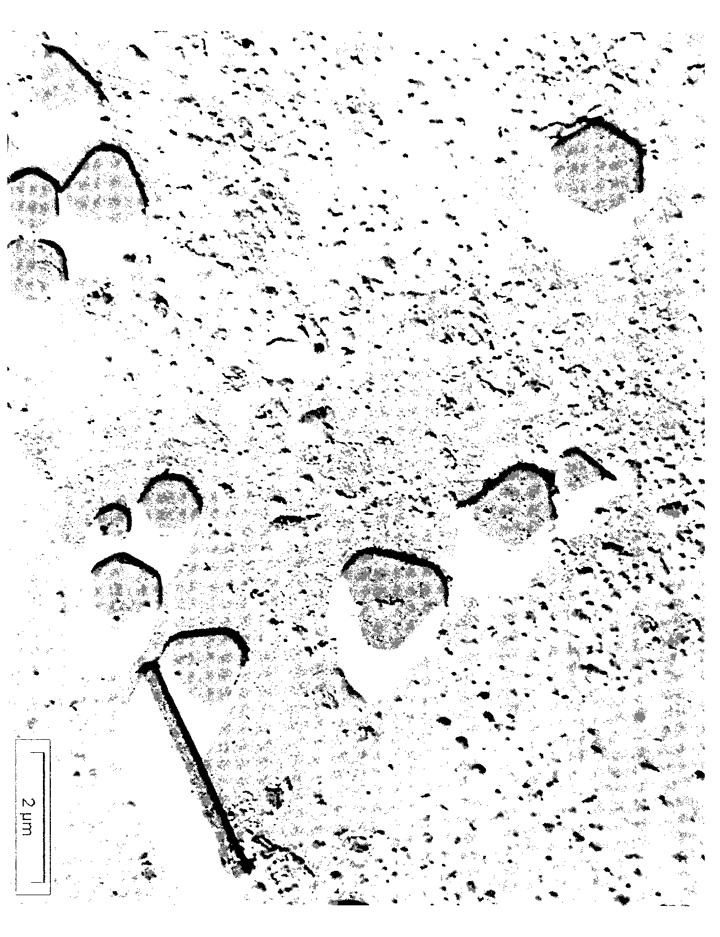

Slide 28
Some Details: Bootstrapping in Nonlinear Regression
You have a sample of n observations of a response variable and a set of predictor variables.
You fit a nonlinear regression model to the data to estimate a set of parameters θ
Let θ denote one of the parameters of interest and its estimate.
Objective: Estimate the sampling distribution of , its standard error, a confidence interval for θ, etc.
To do this, follow the steps of the bootstrap procedure on the subsequent slides

Slide 29
Steps of the Bootstrap Procedure
Generate a "bootstrap" sample (with replacement) of n observations from . Denote the bootstrap sample by
Fit the same type of regression model (with the same set of parameters θ and parameter θ of special interest) to the bootstrapped sample. Denote the estimates for the bootstrapped sample by and
Pick a large number B (e.g., B = 10,000), and repeat Steps (1) and (2) a total of B times, which produces

Slide 30
Steps of the Bootstrap Procedure, continued
Construct a histogram of and calculate:
average of all bootstrapped estimates
standard error of
upper α/2 quantile of the sample distribution of
lower α/2 quantile of the sample distribution of

Slide 31
Steps of the Bootstrap Procedure, continued
A crude 1−α confidence interval for θ is:
A better (reflected) 1−α confidence interval for θ is:

Slide 32




Bootstrap Histograms for the Four Parameters in the Manu. Learning Curve Example (B = 5,000)
$${\hat{θ}}_{0}^{b}$$
$${\hat{θ}}_{1}^{b}$$
$${\hat{θ}}_{2}^{b}$$
$${\hat{θ}}_{3}^{b}$$

Slide 33





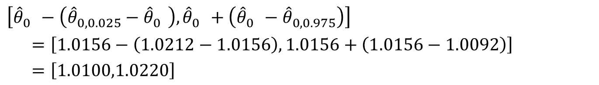
Example CI Calculations for θ₀ for the Manu. Learning Curve Example
$${\hat{θ}}_{0}^{}=1.0156$$
$${\overline{\hat{θ}}}_{0}^{}=1.0158$$
$$SE\left[{\hat{θ}}_{0}^{}\right]=0.0031$$
(from the left-most histogram on previous slide)
$${\hat{θ}}_{0,0.025}^{}=1.0212$$
$${\hat{θ}}_{0,0.975}^{}=1.0092$$
Crude 95% CI:
Reflected 95% CI:
$${\hat{θ}}_{0}^{}±z_{α/2}SE\left[{\hat{θ}}_{0}^{}\right]=1.0156±1.96×0.0031=[1.0095,1.0216]$$
$$\left[{\hat{θ}}_{0}^{}−\left({\hat{θ}}_{0,0.025}^{}−{\hat{θ}}_{0}^{}\right),{\hat{θ}}_{0}^{}+\left({\hat{θ}}_{0}^{}−{\hat{θ}}_{0,0.975}^{}\right)\right]$$
$=\left[1.0156−\left(1.0212−1.0156\right),1.0156+\left(1.0156−1.0092\right)\right]$
$=\left[1.0100,1.0220\right]$

Slide 34
Discussion Points and Questions
What is the difference between the two CIs (crude versus reflected) on the previous slide?
In general, when would the two confidence intervals differ?
What are the effects of increasing B on the bootstrapped histogram of a parameter estimate? Would the histogram become tighter?
What are the effects of increasing n on the bootstrapped histogram of a parameter estimate? Would the histogram become tighter?
Why must n for each bootstrapped sample be the same as n for the real sample?

Slide 35
R commands for bootstrapping parameter SEs/CIs for the manufacturing learning curve
library(boot) #need to load the boot package
MLC<-read.table("MLC.csv",sep=",",header=TRUE)
MLCfit<-function(Z,i,theta0) {
Zboot<-Z[i,]
x1<-Zboot[[1]];x2<-Zboot[[2]];y<-Zboot[[3]]
fn <- function(p) {yhat<-p[1]+p[2]*x1+p[4]*exp(p[3]*x2); sum((y-yhat)^2)}
out<-nlm(fn,p=theta0)
theta<-out$estimate} #parameter estimates
MLCboot<-boot(MLC, MLCfit, R=5000, theta0=c(1,-.05,-.14,-.55))
CovTheta<-cov(MLCboot$t)
SE<-sqrt(diag(CovTheta))
MLCboot
CovTheta
SE
plot(MLCboot,index=1) #index=i calculates results for ith parameter
boot.ci(MLCboot,conf=c(.9,.95,.99),index=1,type=c("norm","basic"))

Slide 36
How do you interpret the covariance matrix of the estimated parameters?
> CovTheta
[,1] [,2] [,3] [,4]
[1,] 9.782095e-06 -9.032514e-06 7.339909e-06 3.748511e-06
[2,] -9.032514e-06 1.681164e-05 -9.442751e-07 -1.333386e-06
[3,] 7.339909e-06 -9.442751e-07 3.374070e-05 4.443156e-05
[4,] 3.748511e-06 -1.333386e-06 4.443156e-05 1.227274e-04
> SE
[1] 0.003127634 0.004100200 0.005808675 0.011078240

Slide 37
> plot(MLCboot,index=1)
> boot.ci(MLCboot,conf=c(.9,.95,.99),index=1,type=c("norm","basic"))
BOOTSTRAP CONFIDENCE INTERVAL CALCULATIONS
Based on 1000 bootstrap replicates
CALL :
boot.ci(boot.out = MLCboot, conf = c(0.9, 0.95, 0.99), type = c("norm",
"basic"), index = 1)
Intervals :
Level Normal Basic
90% ( 1.010, 1.020 ) ( 1.011, 1.020 )
95% ( 1.010, 1.021 ) ( 1.010, 1.022 )
99% ( 1.008, 1.023 ) ( 1.009, 1.023 )

Slide 38
Discussion Points and Questions
In boot.ci, type = "norm" gives our crude CI based on the SE and the normal percentiles, but translated by subtracting out the estimated Bias (taken to be the bootstrap average minus the original parameter estimate); type = “basic” interval gives the better CI obtained by reflecting the percentiles.
How can we determine if there is statistically significant evidence that the asymptotic relative efficiencies of the two manufacturing facilities differ?
What is a 95% CI on the asymptotic relative efficiency of the older facility (x1 = 0)?
What is a 95% CI on the asymptotic relative efficiency of the newer facility (x1 = 1)?
In general, given the covariance matrix S of a random vector Z, the variance of the linear combination a^{T}Z is
Var(a^{T}Z) = a^{T}Sa

Slide 39
Fisher Information Matrix
An alternative to bootstrapping for calculating the covariance matrix and SEs of estimated parameters
Often applicable with large sample size n (“asymptotic” method) and a method of estimation that is similar to MLE
The Fisher info. matrix is
where l(θ) = log f(Y; θ) = "log-likelihood"
(f(Y; θ) = if obsvns in sample are independent)
Note: I(θ) is a p×p matrix with row-j, column-k element:

Slide 40
Why the Fisher Information Matrix is Important
Under fairly general conditions, for large n, the MLE of θ is approximately multivariate normal:
In other words:
(MLEs are approximately unbiased)
Hence, each is approximately normally distributed with mean approximately equal the true parameter θ_{j} (unbiased) and standard deviation

Slide 41
Example: Fisher Info. for Linear Regression
Y_{i} = g(x_{i},β) + ε_{i} (i = 1, 2, . . ., n)
with g(x_{i},β) = β₀ + β₁x_{i1} + . . . + β_{k}x_{ik} = β^{T}x_{i}
and ε_{i} ~ NID(0,σ²)
parameters: θ = β = [β₀, β₁, . . ., β_{k}]^{T}
joint pdf of Y:
log-likelihood: l(β) = −nlog(σ) −n/2×log(2π)
Fisher Info Matrix:

Slide 42
Example Continued
We can use the Fisher information to find approximate CIs on the regression parameters:
where s² = MSE is an estimate of σ²
Approximate 1−α CI for β_{j}:
In general, I(θ) often depends on unknown parameters, in which case we must substitute them by their MLEs:
Use and

Slide 43
Approximating the Fisher Information Matrix
Taking the expectation in the definition of the Fisher info matrix is often intractable, especially for complex models
A common approximation is to use the observed information matrix
To implement (in general, if software doesn’t spit it out)
Use optimization software to find MLE by minimizing -l(θ) = -logf(Y;θ)
Have software calculate the Hessian (second derivative matrix) of -l(θ) at the optimal
Invert the matrix from Step 2 as an approximation of
The square root of the diagonal elements are the SEs of the estimated parameters

Slide 44
Observed Fisher Info Matrix for Nonlinear LS
From the likelihood function for nonlinear LS (MLE for nonlinear regression model with Gaussian errors) that we derived earlier, the log-likelihood is:

Slide 45
R commands for finding Fisher Info for learning curve example (repeat of slide #15)
MLC<-read.table("MLC.csv",sep=",",header=TRUE)
x1<-MLC$Location;x2<-MLC$Week;y<-MLC$Efficiency
fn <- function(p) {yhat<-p[1]+p[2]*x1+p[4]*exp(p[3]*x2); sum((y-yhat)^2)}
out<-nlm(fn,p=c(1,0,-.5,-.1),hessian=TRUE)
theta<-out$estimate #parameter estimates
theta
###the following calculates the SEs#######
MSE<-out$minimum/(length(y) - length(theta)) #estimate of the error variance
InfoMat<-out$hessian/2/MSE #observed information matrix
CovTheta<-solve(InfoMat)
SE<-sqrt(diag(CovTheta)) #standard errors of parameter estimates
MSE
CovTheta
SE

Slide 46
When to Use Which Method for Calculating SEs?
Software will often calculate SEs for you, but the following guidelines apply if you have to calculate them yourself
Important Point: Whatever method you use to calculate SEs for the parameters or predicted response, you use and interpret the SEs the same way
If exact analytical results can be derived (e.g., in standard linear regression with normal errors), use exact analytical results
If n is large enough to invoke asymptotics, and you want an expression for the SEs (which provides useful insight into the quality of the data), use the Fisher info matrix
If n is not large enough to invoke asymptotics (the more complex the model, the larger the required n), use bootstrapping
In certain cases in which the conditions other than n required for the asymptotic results are not met (somewhat rare), use bootstrapping
If there is no underlying probabilistic model for the data (and hence no likelihood or MLEs), in which case the Fisher info matrix is irrelevant, use bootstrapping
If the model is nonparametric, in which case the Fisher info matrix is irrelevant, use bootstrapping
For SEs for the predicted response CIs or PIs with complex nonlinear models, use bootstrapping

Slide 47
CIs/PIs on the Predicted Response
Instead of (or in addition to) CIs on the parameters, what if we want a CI or PI on the predicted response for a specific set of specified values of the predictors?
For this, in nonlinear regression, it is better to use bootstrapping than a modified version of the Fisher Information matrix approach
How would you modify the preceding bootstrapping code if you wanted a CI on the predicted response for the newer facility (x*₁=1) at week # 15 (x*₂=15)?
How would you modify the preceding bootstrapping code if you wanted a PI on the predicted response, instead of a CI?

Slide 48
R commands for bootstrapping response CIs for the manufacturing learning curve
library(boot) #need to load the boot package
MLC<-read.table("MLC.csv",sep=",",header=TRUE)
MLCfit<-function(Z,i,theta0,x_pred) {
Zboot<-Z[i,]
x1<-Zboot[[1]];x2<-Zboot[[2]];y<-Zboot[[3]]
fn <- function(p) {yhat<-p[1]+p[2]*x1+p[4]*exp(p[3]*x2); sum((y-yhat)^2)}
out<-nlm(fn,p=theta0)
theta<-out$estimate
y_pred<- theta[1]+theta[2]*x_pred[1]+theta[4]*exp(theta[3]*x_pred[2])} #predicted response
MLCboot<-boot(MLC, MLCfit, R=5000, theta0=c(1,-.05,-.14,-.55), x_pred=c(1,15))
MLCboot
VarYhat<-var(MLCboot$t); VarYhat
SEYhat<-sqrt(VarYhat); SEYhat
plot(MLCboot)
boot.ci(MLCboot,conf=c(.9,.95,.99),type=c("norm","basic"))

Slide 49
> plot(MLCboot)
> plot(MLCboot)
> boot.ci(MLCboot,conf=c(.9,.95,.99),type=c("norm","basic"))
BOOTSTRAP CONFIDENCE INTERVAL CALCULATIONS
Based on 1000 bootstrap replicates
CALL :
boot.ci(boot.out = MLCboot, conf = c(0.9, 0.95, 0.99), type = c("norm",
"basic"))
Intervals :
Level Normal Basic
90% ( 0.8872, 0.9040 ) ( 0.8872, 0.9038 )
95% ( 0.8856, 0.9056 ) ( 0.8853, 0.9058 )
99% ( 0.8824, 0.9087 ) ( 0.8816, 0.9083 )

Slide 50
Bootstrapping Prediction Intervals (PIs) for the Response
The R code on the preceding slide calculates a CI on g(x*,θ). However, a PI on Y* = g(x*,θ) + ε* is often more relevant. The preceding CI and the analogous PI are:
CI on g(x*,θ):
with {g_{1−α/2},g_{α/2}} = {lower, upper} α/2 quantiles of
PI on Y*:
with {y_{1−α/2},y_{α/2}} = {lower, upper} α/2 quantiles of
and the ε^{b} are randomly generated using direct simulation
A simpler (but usually acceptable) CI and PI are:
CI on g(x*,θ):
PI on Y*:
with from bootstrapping and = MSE

Slide 51
Additional R commands for bootstrapping response PIs for the manufacturing learning curve
#more complex PI
Yhat0<-MLCboot$t0 #predicted response using actual estimated parameters
Yhatboot<-MLCboot$t
MSE <- 0.0001266 #from slide 45
e<-rnorm(nrow(Yhatboot), mean=0, sd=sqrt(MSE))
Yboot<-Yhatboot-e
Yquant<-quantile(Yboot,prob=c(.025,.975))
L<-2*Yhat0-Yquant[2]
U<-2*Yhat0-Yquant[1]
hist(Yboot,100)
c(L,U) #more complex PI
#simpler PI
SEY<-sqrt(var(Yhatboot)+MSE); SEY
c(Yhat0-qnorm(.975)*SEY, Yhat0+qnorm(.975)*SEY) #simpler PI
Note that we could also have calculated the more complex PI by subtracting the randomly generated error e from y_pred in the last line of the MLCfit function of the previous code

Slide 52
> c(L,U)
97.5% 2.5%
0.8724212 0.9210745
> SEY
[,1]
[1,] 0.01269309
How does the histogram and response PI here compare with the histogram for and the response CI?

Slide 53
Shrinkage (aka Regularization)
We just saw that using λ > 0 when fitting the neural network model was essential
In the model fitting optimization criterion for supervised learning methods in general, including a penalty for large parameters is very common and very helpful
Ridge regression to improve linear regression is an example of shrinkage
Originally designed as a fix for multicollinearity in linear regression
The effects of multicollinearity (terrible prediction for cases with unusual predictors, erratic coefficient values; inflated P-values) are quite similar to the effects of overfitting (k almost as large as n)

Slide 54
Illustration of Multicollinearity in Linear Regression
For Y = β₀ + β₁x₁ + β₂x₂ + ε
x₁ and x₂ not multicollinear,
fitted plane stable,
SE[β's] reasonable
x₁ and x₂ multicollinear,
fitted plane unstable,
SE[β's] very large
y
y
x₂
x₂
x₁ = x₂
x₁
x₁

Slide 55
An Example of (Lurking) Multicollinearity
Data in barstock.csv
30 cases, 5 variables. Each row is the weight, volume, height, width, and length of a roughly cube-shaped piece of stock metal, cut from bar with 1" square cross-section
Something strange happens when you fit a linear regression model to predict weight as a function of the other variables

Slide 56
Read the Data and Preliminary Analysis
X<-read.table("barstock.csv",sep=",",header=T)
R<-cor(X[2:5]); round(R,3)
pairs(X)
> round(R,3)
volume height width length
volume 1.000 0.369 0.548 0.738
height 0.369 1.000 -0.361 0.054
width 0.548 -0.361 1.000 0.182
length 0.738 0.054 0.182 1.000
Does multicollinearity appear to be a serious problem?

Slide 57
Conduct a Linear Regression
out<-lm(weight~.,data=X)
summary(out)
Coefficients:
Estimate Std. Error t value Pr(>|t|)
(Intercept) -32.85 37.75 -0.870 0.392
volume -13.92 18.84 -0.739 0.467
height 16.87 18.98 0.889 0.383
width 16.83 18.86 0.892 0.381
length 17.08 18.75 0.911 0.371
Residual standard error: 0.01179 on 25 degrees of freedom
Multiple R-squared: 0.9439, Adjusted R-squared: 0.9349
F-statistic: 105.1 on 4 and 25 DF, p-value: 2.975e-15
Notice anything strange?

Slide 58
Explanation of What Happened
attach(X); plot(height+width+length,volume); detach(X)
VIF<-diag(solve(R))
sqrt(VIF)
> sqrt(VIF)
volume height width length
127.22135 72.60348 82.28589 74.98207
Together, the four predictors are very nearly linearly related, which is multicollinearity by definition
volume – height – width – length ≅ constant

Slide 59
Mathematical Reason why Multicollinearity Causes Problems in Regression (and in every supervised learning method)
Recall and
Multicollinearity ⇔ some columns of X nearly linearly
(or overfitting) dependent
⇔ nearly singular (not invertible)
⇔ really large
⇔ and really large

Slide 60
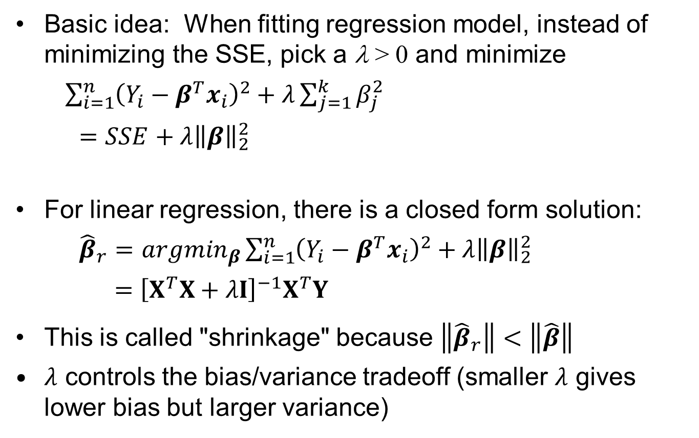
Ridge Regression
Basic idea: When fitting regression model, instead of minimizing the SSE, pick a λ > 0 and minimize
$\sum_{i=1}^{n}{{\left(Y_{i}−β^{T}x_{i}\right)}^{2}}+λ\sum_{j=1}^{k}{β_{j}^{2}}$
$=SSE+λ{\left\|β\right\|}_{2}^{2}$
For linear regression, there is a closed form solution:
${\hat{β}}_{r}={argmin}_{β}\sum_{i=1}^{n}{{\left(Y_{i}−β^{T}x_{i}\right)}^{2}}+λ{\left\|β\right\|}_{2}^{2}$
$={\left[X^{T}X+λI\right]}^{−1}X^{T}Y$
This is called "shrinkage" because $\left\|{\hat{β}}_{r}\right\|<\left\|\hat{β}\right\|$
$λ$ controls the bias/variance tradeoff (smaller $λ$ gives lower bias but larger variance)

Slide 61
Bias/Variance Tradeoff in Estimation
In any parameter estimation problem, bias and variance are two components of the mean square error (MSE):
(variance)
(bias)
(mean square error)
Often there is no free lunch, and estimators that have better bias generally have worse variance, and vice-versa

Slide 62
Implementing Ridge Regression
Important: Standardize all predictors
Choose a large initial λ (e.g., λ = n)
Fit the ridge regression model (MASS:lm.ridge)
Reduce λ (i.e., reset λ → λ/1.5) and go to Step 3. Repeat until λ ≈ 0
Choose the best value of λ by either:
inspecting a plot of versus λ and choosing the smallest λ after which stabilizes
C_{p} with the “model complexity” p replaced by the equivalent number of fitted parameters trace(X[X^{T}X+λI]⁻¹X^{T})
Generalized cross-validation (GCV), similar to AIC and C_{p}
Whatever criterion your software has (there are a few other analytical criteria)
As always, cross-validation can be used

Slide 63
Ridge Regression Example (barstock.csv data)
library(MASS) #needed for ridge regression
X<-read.table("barstock.csv",sep=",",header=T)
X1<-sapply(X, function(x) (x-mean(x))/sd(x)) #standardize predictors and response
X1<-data.frame(X1)
out<-lm(weight~. -1,data=X1); summary(out)
Coefficients:
Estimate Std. Error t value Pr(>|t|)
volume -4.454 5.912 -0.753 0.458
height 3.058 3.374 0.906 0.373
width 3.479 3.824 0.910 0.371
length 3.236 3.484 0.929 0.362
lambda<-vector(mode="numeric",length=20)
for (i in 1:20) lambda[21-i]<-1/(1.5^(i-1))
outridge<-lm.ridge(weight~. -1,data=X1, lambda=lambda)
plot(outridge); select(outridge)
modified HKB estimator is 0.002503323
modified L-W estimator is 0.1372694
smallest value of GCV at 0.6666667

Slide 64
Ridge plot for barstock data

Slide 65
Ridge Regression CV Ex. (barstock.csv data)
n=30;K=10
Ind<-CVInd(n=n,K=K)
y<-X1[[1]]
yhat<-y
for (k in 1:K) {
out<-lm.ridge(weight~. -1,data=X1[-Ind[[k]],], lambda=.137)
yhat[Ind[[k]]]<-as.matrix(X1[Ind[[k]],2:5])%*%out$coef
}
CVSSE1 = sum((y-yhat)^2) #CV SSE
#now compare to a different shrinkage parameter
yhat<-y
for (k in 1:K) {
out<-lm.ridge(weight~. -1,data=X1[-Ind[[k]],], lambda=.667)
yhat[Ind[[k]]]<-as.matrix(X1[Ind[[k]],2:5])%*%out$coef
}
CVSSE2 = sum((y-yhat)^2) #CV SSE
c(CVSSE1,CVSSE2)

Slide 66
Discussion Points and Questions
Which estimated coefficients (for λ = 0 or for λ = 0.2) make more sense?
n-fold CV indicates that λ = 0.001 is slightly better than λ = 0.137 or λ = 0.667, but this is probably not correct
Averaging SSE_{CV} for 10-fold CV across many replicates indicates that λ = 0.001 is worse, and the resulting SSE_{CV} has much higher variability
In general, averaging across multiple replicates of K-fold CV is better than using n-fold CV
Regarding the bias/variance tradeoff, as λ increases:
does increase or decrease?
does increase or decrease?

Slide 67
Shrinkage/Complexity in General
The general shrinkage criterion for fitting supervised learning models is to minimize
Here, λ can be viewed as a complexity penalty parameter:
As λ → ∞, the model becomes less complex (all coefficients shrink to zero), which increases the bias but decreases the variance of the parameter estimates
As λ → 0, the model becomes more complex, which decreases the bias but increases the variance of the parameter estimates
Most models we will cover have complexity parameters that must be chosen (usually via cross validation)

Slide 68
Shrinkage Vs. Variable Selection
Contrast the effects of varying the complexity parameter in best subsets (or stepwise) versus ridge regression:
In ridge, as λ increases, all terms remain in the model, but their coefficients shrink to zero
In best subsets, as λ increases, the coefficients remain of normal size, but the number of terms decreases to zero
Note: In best subsets, we choose the complexity measure p that minimizes C_{p} = SSE_{p} + λp with
The LASSO criterion is intended to be a hybrid that shrinks some coefficients and drops other variables. It minimizes:

Slide 69
Example Illustrating Ridge Vs. LASSO Regression
See Ch. 3 of HTF for further description of LASSO and this example
The predictive modeling objective is to predict the level of a prostate specific antigen (the response variable) as a function of a number of other clinical measurements (8 predictors total).
On the next slide, the vertical axes are the estimated coefficients from ridge regression (left panel) and LASSO regression (right panel). The horizontal axes are complexity parameters that monotonically decrease in λ. The 8 plotted curves represent the 8 predictor coefficients.

Slide 70
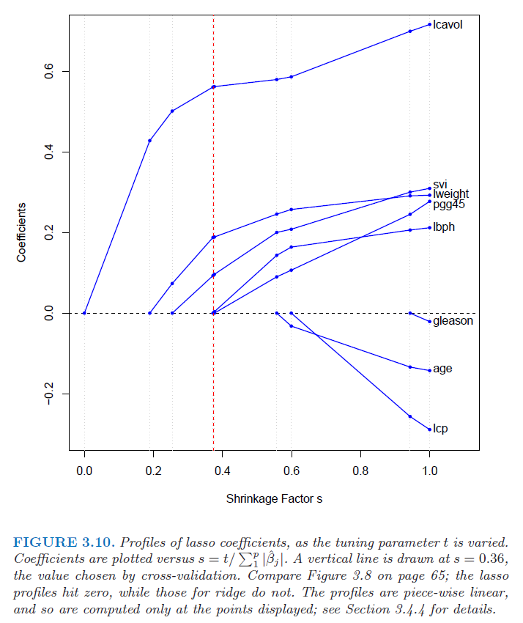
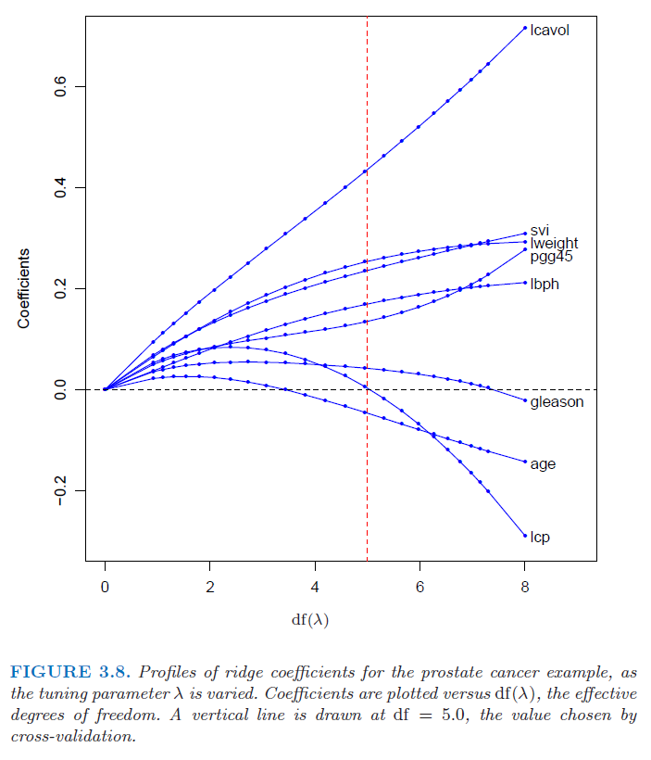
Plots of the Estimated Ridge and LASSO Coefficients versus Complexity Parameter

Slide 71
Discussion Points and Questions
Why does the LASSO penalty tend to completely drop some terms from the model, as opposed to keeping the terms in the model but shrinking their coefficients (like ridge regression)? See Figure 3.11 of HTF
What is the potential advantage of shrinking coefficients AND dropping some terms via LASSO, versus just shrinking coefficients via ridge regression?

Slide 72
Model Selection and Evaluation
This is used to:
Decide which predictors (or which terms for nonlinear models) belong in the model
Select tuning parameters in models (e.g., the regularization parameter in ridge and LASSO regression)
More generally, to select the best model from among completely different types of models
More generally still, evaluate the predictive quality of the models
Most evaluation criteria are intended to assess how well the fitted model would do predicting a new, independent test case or random set of test cases
You CANNOT just look at which model fits the training data the best (e.g., via r²), because the more complex model will always appear to fit better (overfitting)

Slide 73
Model Selection and Evaluation Criteria
These are all model evaluation criteria, not model/variable selection methods. But they can be used to select models, e.g., within model/variable selection methods like stepwise, best subsets, or simply just comparing two different models
Mallow’s Cp, AIC, BIC, etc. are all analytical criteria:
They attempt to analytically evaluate how well the model will predict a new test case
They all penalize models for having (i) a worse fit to the training data and (ii) higher complexity (e.g., more terms)
Cross validation (CV) is an empirical assessment of how well the model will predict a new test case
The analytical criteria are derived based on specific models, and mainly apply to comparing models of the same type but with different number of parameters
CV is much more general
CV is also more computationally expensive (so analytical criteria are still useful and sometimes necessary)

Slide 74
Analytical Model Selection Criteria -- Basics
p = # fitted parameters
n = # training observations
{Y_{new}, X_{new}}: {response, predictors} pair drawn randomly from test population
: estimated from training data for p-parameter model
Ideal, but generally intractable, evaluation criterion (for Y_{i} = g(x_{i},θ) + ε_{i} and squared-error loss):
where E[] is w.r.t. {Y_{new}, X_{new}}
Next best, and more tractable, criterion:
where E[] is w.r.t. {Y_{new}, X_{new}} and training data

Slide 75
Mallow's Cp
Applicable when linear LS used to fit model Y_{i} = g(x_{i},θ) + ε_{i}, not necessarily with normal errors
(smaller is better)
where
SSE_{p} = SSE for p-parameter model
= estimate of Var(ε)
= MSE for most complex model (usually)
Rationale: C_{p} is an estimate of the expected “in-sample” squared error:
( for p-parameter model)

Slide 76
Akaike Info Criterion (AIC): A Generalization of Cp
Applicable when MLE used to fit fairly general p-parameter model
(smaller is better)
where = maximized log-likelihood for p-parameter model
Rationale: AIC is an estimate is estimate of (−2 times) the expected “in-sample log-likelihood”:
( for p-parameter model)

Slide 77
Bayesian Information Criterion (BIC)
Alternative to AIC, with the same applicability
(smaller is better)
Identical to AIC but with 2 → log(n)
Rationale: Choosing the model with smallest BIC is equivalent to choosing the model with the highest posterior model probability (for a uniform prior model probability)

Slide 78
K-Fold Cross-Validation
See handout Notes 1a Cross-Validation.pdf

Slide 79
R commands for creating indices of partition for K-fold CV
CVInd <- function(n,K) { #n is sample size; K is number of parts; returns K-length list of indices for each part
m<-floor(n/K) #approximate size of each part
r<-n-m*K
I<-sample(n,n) #random reordering of the indices
Ind<-list() #will be list of indices for all K parts
length(Ind)<-K
for (k in 1:K) {
if (k <= r) kpart <- ((m+1)*(k-1)+1):((m+1)*k)
else kpart<-((m+1)*r+m*(k-r-1)+1):((m+1)*r+m*(k-r))
Ind[[k]] <- I[kpart] #indices for kth part of data
}
Ind
}

Slide 80
Shell for running multiple random replicates of CV
Nrep<-20 #number of replicates of CV
K<-10 #K-fold CV on each replicate
n.models = 3 #number of different models to fit and compare
n=nrow(MLC)
y<-MLC$Efficiency
yhat=matrix(0,n,n.models)
MSE<-matrix(0,Nrep,n.models)
for (j in 1:Nrep) {
Ind<-CVInd(n,K)
for (k in 1:K) {
out<-lm(Efficiency~.,MLC[-Ind[[k]],]) #the first model to compare
yhat[Ind[[k]],1]<-as.numeric(predict(out,MLC[Ind[[k]],]))
out<-lm(Efficiency ~ . - Location,MLC[-Ind[[k]],]) #the second model to compare
yhat[Ind[[k]],2]<-as.numeric(predict(out,MLC[Ind[[k]],]))
out<-lm(Efficiency ~ .^2, MLC[-Ind[[k]],]) #the third model to compare
yhat[Ind[[k]],3]<-as.numeric(predict(out,MLC[Ind[[k]],]))
} #end of k loop
MSE[j,]=apply(yhat,2,function(x) sum((y-x)^2))/n
} #end of j loop
MSE
MSEAve<- apply(MSE,2,mean); MSEAve #averaged mean square CV error
MSEsd <- apply(MSE,2,sd); MSEsd #SD of mean square CV error
r2<-1-MSEAve/var(y); r2 #CV r^2

Slide 81
Using the preceding for K-fold CV for Manu. Learning Curve Data
Nrep<-20 #number of replicates of CV
K<-10 #K-fold CV on each replicate
n.models = 2 #number of different models to fit and compare
FitFun1 <- function(x1,x2,p) p[1]+p[2]*x1+p[4]*exp(p[3]*x2)
FitFun2 <- function(x1,x2,p) p[1]+p[3]*exp(p[2]*x2)
n=nrow(MLC)
y<-MLC$Efficiency
yhat=matrix(0,n,n.models)
MSE<-matrix(0,Nrep,n.models)
for (j in 1:Nrep) {
Ind<-CVInd(n,K)
for (k in 1:K) {
out<-nls(Efficiency~FitFun1(Location,Week,p),data=MLC[-Ind[[k]],],start=list(p=c(1,-.05,-.15,-.55)))
yhat[Ind[[k]],1]<-as.numeric(predict(out,MLC[Ind[[k]],]))
out<-nls(Efficiency~FitFun2(Location,Week,p),data=MLC[-Ind[[k]],],start=list(p=c(1,-.15,-.55)))
yhat[Ind[[k]],2]<-as.numeric(predict(out,MLC[Ind[[k]],]))
} #end of k loop
MSE[j,]=apply(yhat,2,function(x) sum((y-x)^2))/n
} #end of j loop
MSE
MSEAve<- apply(MSE,2,mean); MSEAve #averaged mean square CV error
MSEsd <- apply(MSE,2,sd); MSEsd #SD of mean square CV error
r2<-1-MSEAve/var(y); r2 #CV r^2

Slide 82
R commands for AIC and CV for a logistic regression model for the car purchase data
library(boot)
CAR<-read.table("Car.csv",sep=",",header=TRUE)
n<-nrow(CAR)
car.fit<-glm(y~income+car_age,family=binomial(link = "logit"),data=CAR)
summary(car.fit)
AIC<- -2*as.numeric(logLik(car.fit))/n+2*3/n
out<-cv.glm(CAR, car.fit, function(y,phat) -mean(log(phat)*y+log(1-phat)*(1-y)), K=11)
AIC
car.fit$aic/n
out$delta
car.fit<-glm(y~income+car_age+income:car_age, family=binomial(link = "logit"),data=CAR)
summary(car.fit)
AIC<- -2*as.numeric(logLik(car.fit))/n+2*4/n
out<-cv.glm(CAR, car.fit, function(y,phat) -mean(log(phat)*y+log(1-phat)*(1-y)), K=11)
AIC
car.fit$aic/n
out$delta

Slide 83
> summary(car.fit)
glm(formula = y ~ income + car_age, family = binomial(link = "logit"),
data = CAR)
Coefficients:
Estimate Std. Error z value Pr(>|z|)
(Intercept) -4.73931 2.10195 -2.255 0.0242 *
income 0.06773 0.02806 2.414 0.0158 *
car_age 0.59863 0.39007 1.535 0.1249
AIC: 42.69
> AIC
[1] 1.293625
> car.fit$aic/n
[1] 1.293625
> out$delta
[1] 0.6928546 0.6857222
> summary(car.fit)
glm(formula = y ~ income + car_age + income:car_age, family = binomial(link = "logit"),
data = CAR)
Coefficients:
Estimate Std. Error z value Pr(>|z|)
(Intercept) -2.372993 2.862477 -0.829 0.407
income 0.001326 0.064770 0.020 0.984
car_age -0.303860 0.890512 -0.341 0.733
income:car_age 0.028860 0.026493 1.089 0.276
AIC: 43.404
> AIC
[1] 1.315276
> car.fit$aic/n
[1] 1.315276
> out$delta
[1] 0.7334941 0.7230012

Slide 84
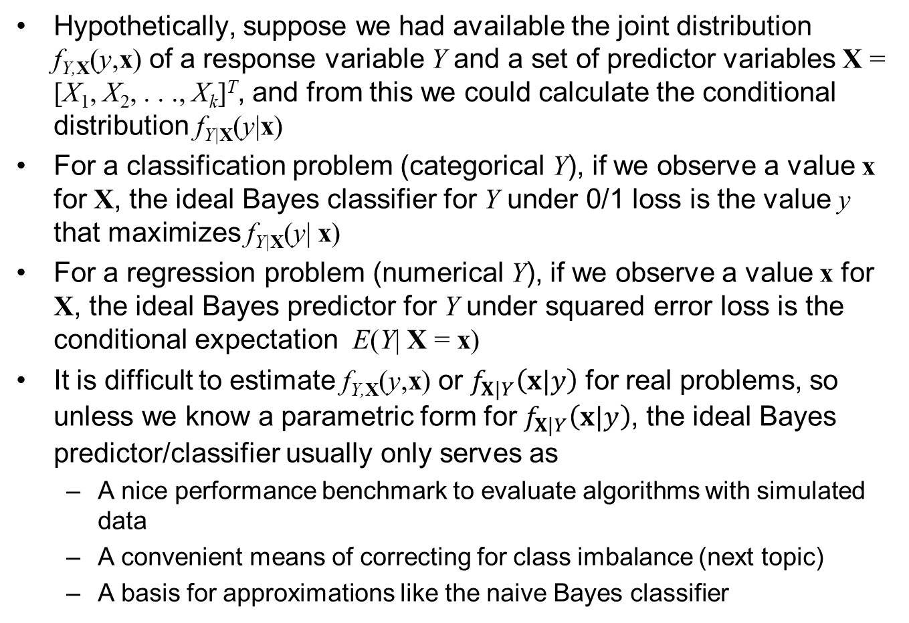
Ideal Bayes Predictor and Classifier
Hypothetically, suppose we had available the joint distribution f_{Y,X}(y,x) of a response variable Y and a set of predictor variables X = [X₁, X₂, . . ., X_{k}]^{T}, and from this we could calculate the conditional distribution f_{Y|X}(y|x)
For a classification problem (categorical Y), if we observe a value x for X, the ideal Bayes classifier for Y under 0/1 loss is the value y that maximizes f_{Y|X}(y| x)
For a regression problem (numerical Y), if we observe a value x for X, the ideal Bayes predictor for Y under squared error loss is the conditional expectation E(Y| X = x)
It is difficult to estimate f_{Y,X}(y,x) or $f_{X|Y}\left(x|y\right)$ for real problems, so unless we know a parametric form for $f_{X|Y}\left(x|y\right)$, the ideal Bayes predictor/classifier usually only serves as
A nice performance benchmark to evaluate algorithms with simulated data
A convenient means of correcting for class imbalance (next topic)
A basis for approximations like the naive Bayes classifier

Slide 85
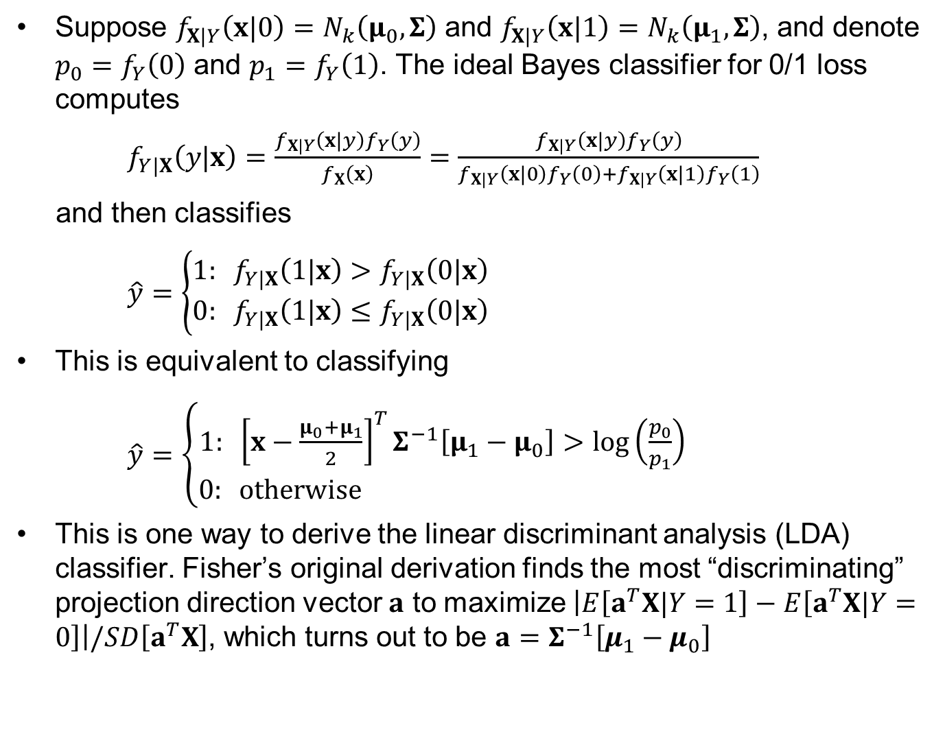
Ideal Bayes Binary Classifier with MVN $f_{X|Y}\left(x|y\right)$
Suppose $f_{X|Y}\left(x|0\right)=N_{k}\left(μ_{0},Σ\right)$ and $f_{X|Y}\left(x|1\right)=N_{k}\left(μ_{1},Σ\right)$, and denote $p_{0}=f_{Y}\left(0\right)$ and $p_{1}=f_{Y}\left(1\right)$. The ideal Bayes classifier for 0/1 loss computes
$f_{Y|X}\left(y|x\right)=\frac{f_{X|Y}\left(x|y\right)f_{Y}\left(y\right)}{f_{X}\left(x\right)}=\frac{f_{X|Y}\left(x|y\right)f_{Y}\left(y\right)}{f_{X|Y}\left(x|0\right)f_{Y}\left(0\right)+f_{X|Y}\left(x|1\right)f_{Y}\left(1\right)}$
and then classifies
$\hat{y}=\left\{\begin{matrix}1: f_{Y|X}\left(1|x\right)>f_{Y|X}\left(0|x\right) \\ 0: f_{Y|X}\left(1|x\right)≤f_{Y|X}\left(0|x\right)\end{matrix}\right.$
This is equivalent to classifying
$\hat{y}=\left\{\begin{matrix}1: {\left[x−\frac{μ_{0}+μ_{1}}{2}\right]}^{T}Σ^{−1}\left[μ_{1}−μ_{0}\right]>log\left(\frac{p_{0}}{p_{1}}\right) \\ 0: otherwise \end{matrix}\right.$
This is one way to derive the linear discriminant analysis (LDA) classifier. Fisher’s original derivation finds the most “discriminating” projection direction vector $a$ to maximize $\left|E\left[a^{T}X|Y=1\right]−E\left[a^{T}X|Y=0\right]\right|/SD\left[a^{T}X\right]$, which turns out to be $a=Σ^{−1}\left[μ_{1}−μ_{0}\right]$

Slide 86
Class Balancing with Infrequent Class Events
In classification, when one response class occurs very infrequently, the training data are often balanced before fitting a model to give better results
Artificially balancing the training data is achieved by assigning observations (rows) weights that differ, by random downsampling the more common class, or by random upsampling the less common class
If you fit a model to artificially balanced training data, you must correct for the balancing in the final model if you want correct predicted class probabilities (sometimes this is unnecessary if all you want is a scoring direction)
Bayes classifier concepts provide a convenient means to correct for artificial balancing

Slide 87
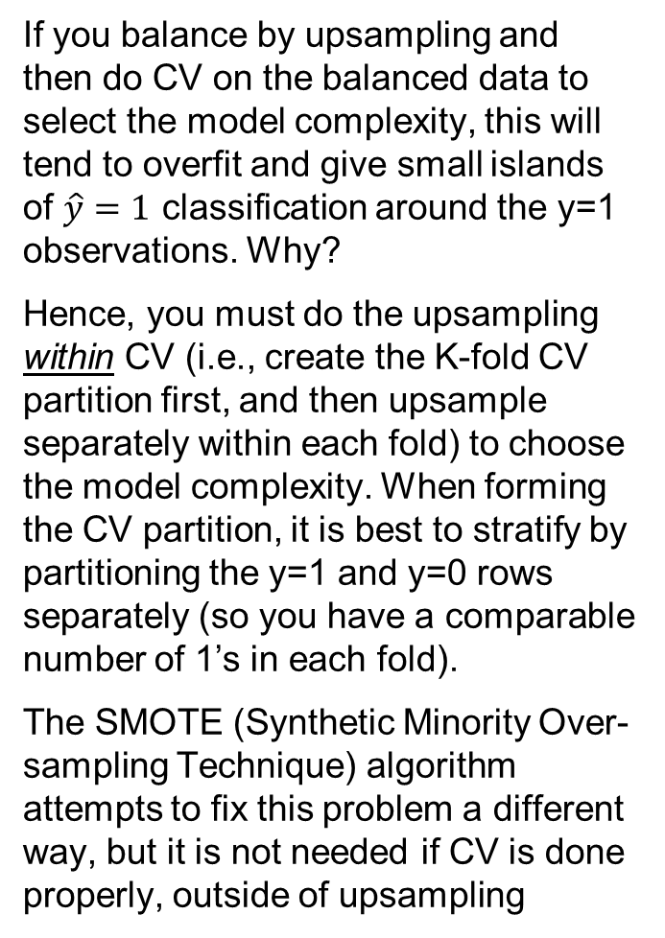
Caveat on Upsampling, Overfitting, and CV
If you balance by upsampling and then do CV on the balanced data to select the model complexity, this will tend to overfit and give small islands of $\hat{y}=1$ classification around the y=1 observations. Why?
Hence, you must do the upsampling within CV (i.e., create the K-fold CV partition first, and then upsample separately within each fold) to choose the model complexity. When forming the CV partition, it is best to stratify by partitioning the y=1 and y=0 rows separately (so you have a comparable number of 1’s in each fold).
The SMOTE (Synthetic Minority Over-sampling Technique) algorithm attempts to fix this problem a different way, but it is not needed if CV is done properly, outside of upsampling
2D example with 980 zeros and 20 ones in the training data

Slide 88
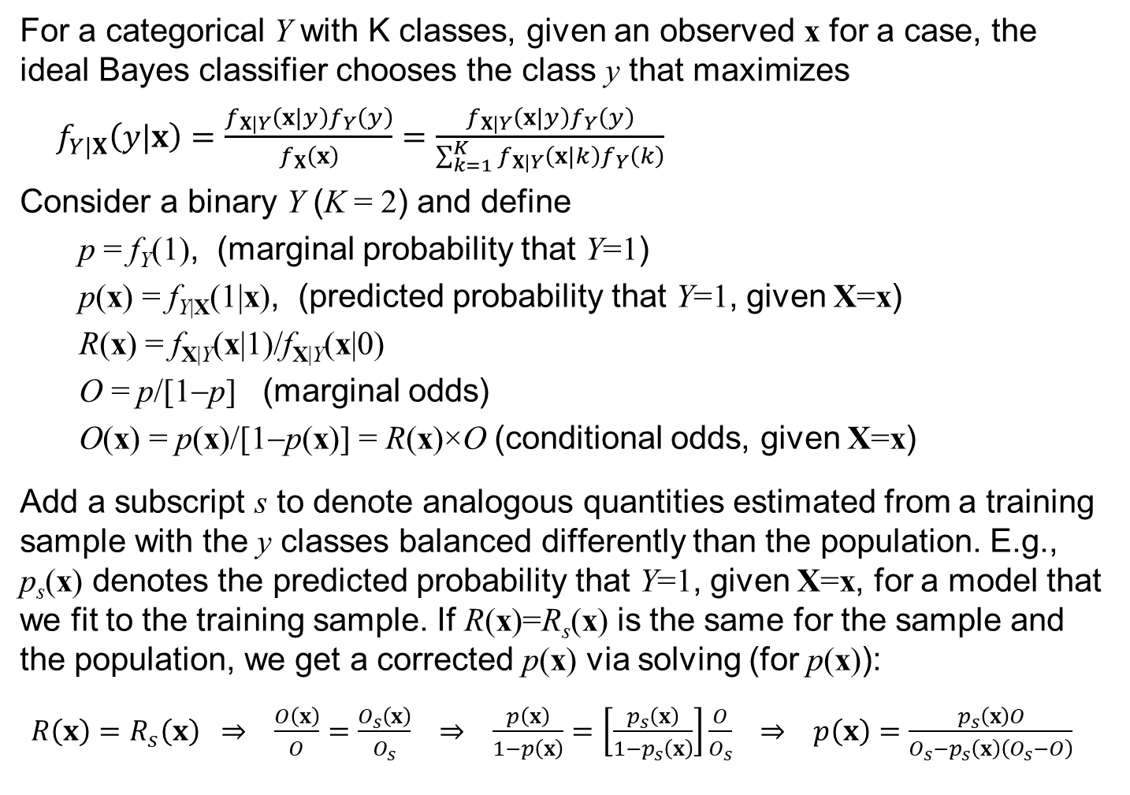
Imbalance Correction Via Bayes Classifier Concepts
For a categorical Y with K classes, given an observed x for a case, the ideal Bayes classifier chooses the class y that maximizes
$f_{Y|X}\left(y|x\right)=\frac{f_{X|Y}\left(x|y\right)f_{Y}\left(y\right)}{f_{X}\left(x\right)}=\frac{f_{X|Y}\left(x|y\right)f_{Y}\left(y\right)}{\sum_{k=1}^{K}{f_{X|Y}\left(x|k\right)f_{Y}\left(k\right)}}$
Consider a binary Y (K = 2) and define
p = f_{Y}(1), (marginal probability that Y=1)
p(x) = f_{Y|X}(1|x), (predicted probability that Y=1, given X=x)
R(x) = f_{X|Y}(x|1)/f_{X|Y}(x|0)
O = p/[1−p] (marginal odds)
O(x) = p(x)/[1−p(x)] = R(x)×O (conditional odds, given X=x)
Add a subscript s to denote analogous quantities estimated from a training sample with the y classes balanced differently than the population. E.g., p_{s}(x) denotes the predicted probability that Y=1, given X=x, for a model that we fit to the training sample. If R(x)=R_{s}(x) is the same for the sample and the population, we get a corrected p(x) via solving (for p(x)):
$R\left(x\right)=R_{s}\left(x\right) ⇒ \frac{O\left(x\right)}{O}=\frac{O_{s}\left(x\right)}{O_{s}} ⇒ \frac{p\left(x\right)}{1−p\left(x\right)}=\left[\frac{p_{s}\left(x\right)}{1−p_{s}\left(x\right)}\right]\frac{O}{O_{s}} ⇒ p\left(x\right)=\frac{p_{s}\left(x\right)O}{O_{s}−p_{s}\left(x\right)\left(O_{s}−O\right)}$

Slide 89
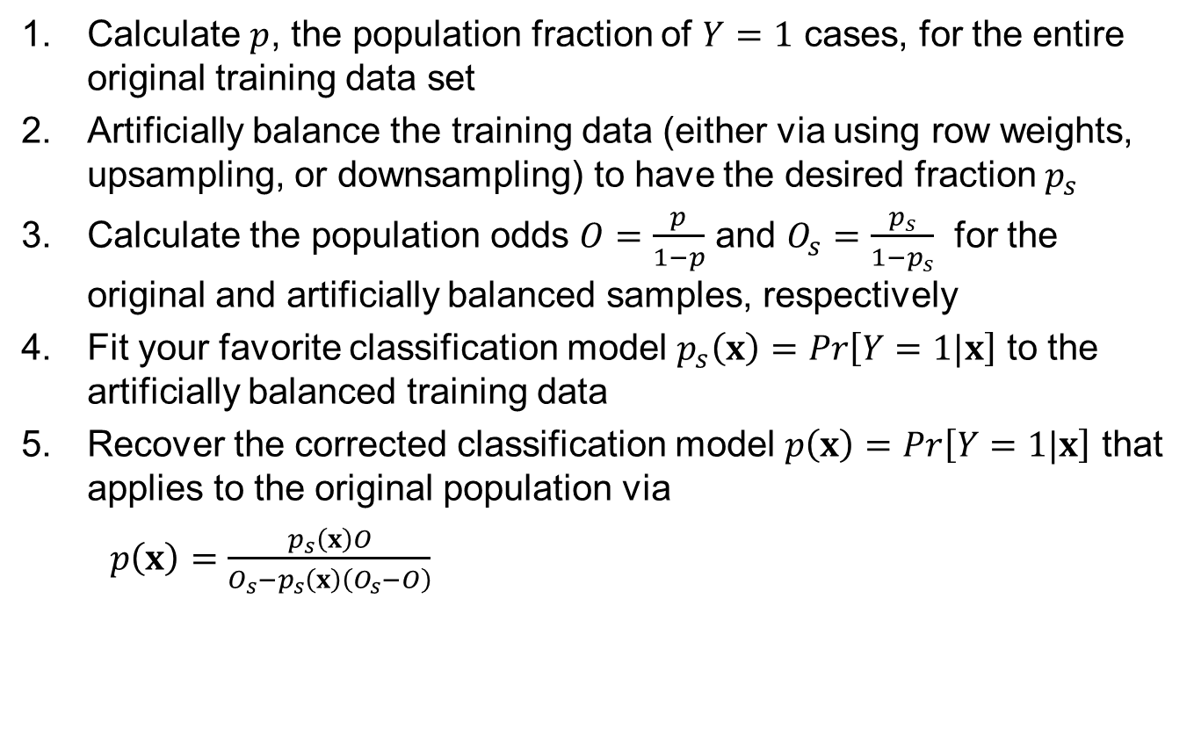
Steps Involved for Imbalance Correction
Calculate $p$, the population fraction of $Y=1$ cases, for the entire original training data set
Artificially balance the training data (either via using row weights, upsampling, or downsampling) to have the desired fraction $p_{s}$
Calculate the population odds $O=\frac{p}{1−p}$ and $O_{s}=\frac{p_{s}}{1−p_{s}}$ for the original and artificially balanced samples, respectively
Fit your favorite classification model $p_{s}\left(x\right)=Pr\left[Y=1|x\right]$ to the artificially balanced training data
Recover the corrected classification model $p\left(x\right)=Pr\left[Y=1|x\right]$ that applies to the original population via
$p\left(x\right)=\frac{p_{s}\left(x\right)O}{O_{s}−p_{s}\left(x\right)\left(O_{s}−O\right)}$

Slide 90
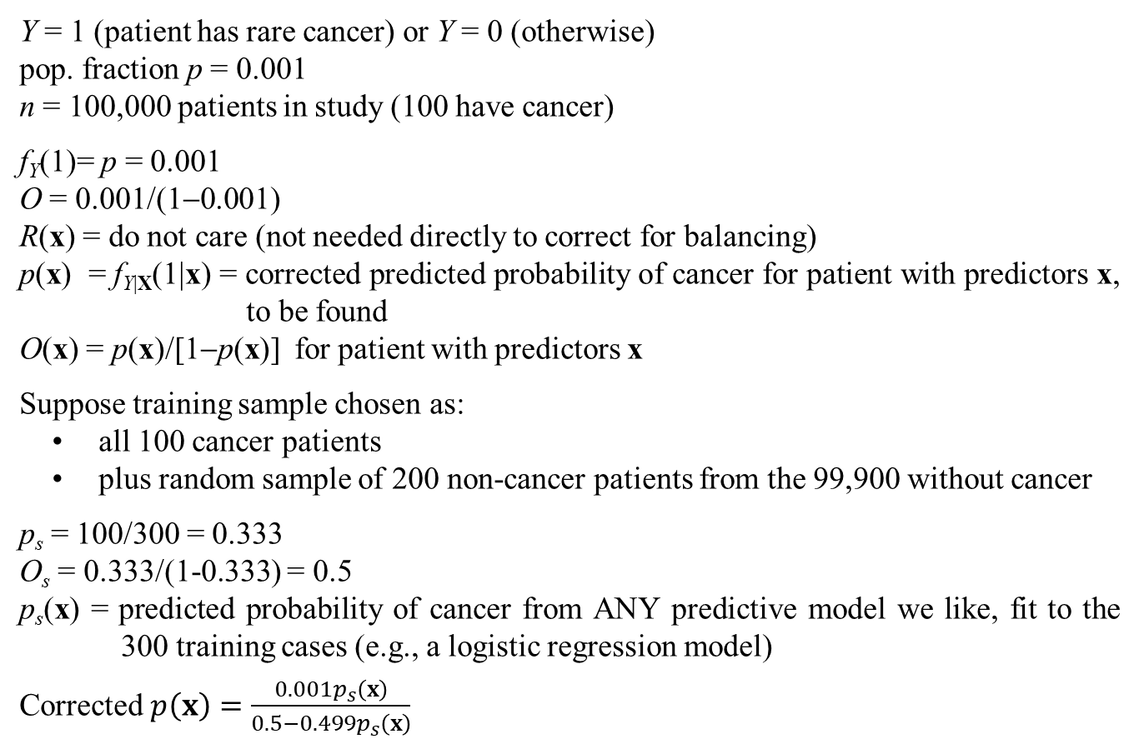
Example: Medical Risk Modeling for Rare Cancer
Y = 1 (patient has rare cancer) or Y = 0 (otherwise)
pop. fraction p = 0.001
n = 100,000 patients in study (100 have cancer)
f_{Y}(1)= p = 0.001
O = 0.001/(1−0.001)
R(x) = do not care (not needed directly to correct for balancing)
p(x) = f_{Y|X}(1|x) = corrected predicted probability of cancer for patient with predictors x, to be found
O(x) = p(x)/[1−p(x)] for patient with predictors x
Suppose training sample chosen as:
all 100 cancer patients
plus random sample of 200 non-cancer patients from the 99,900 without cancer
p_{s} = 100/300 = 0.333
O_{s} = 0.333/(1-0.333) = 0.5
p_{s}(x) = predicted probability of cancer from ANY predictive model we like, fit to the 300 training cases (e.g., a logistic regression model)
Corrected $p\left(x\right)=\frac{0.001p_{s}\left(x\right)}{0.5−0.499p_{s}\left(x\right)}$

Slide 91
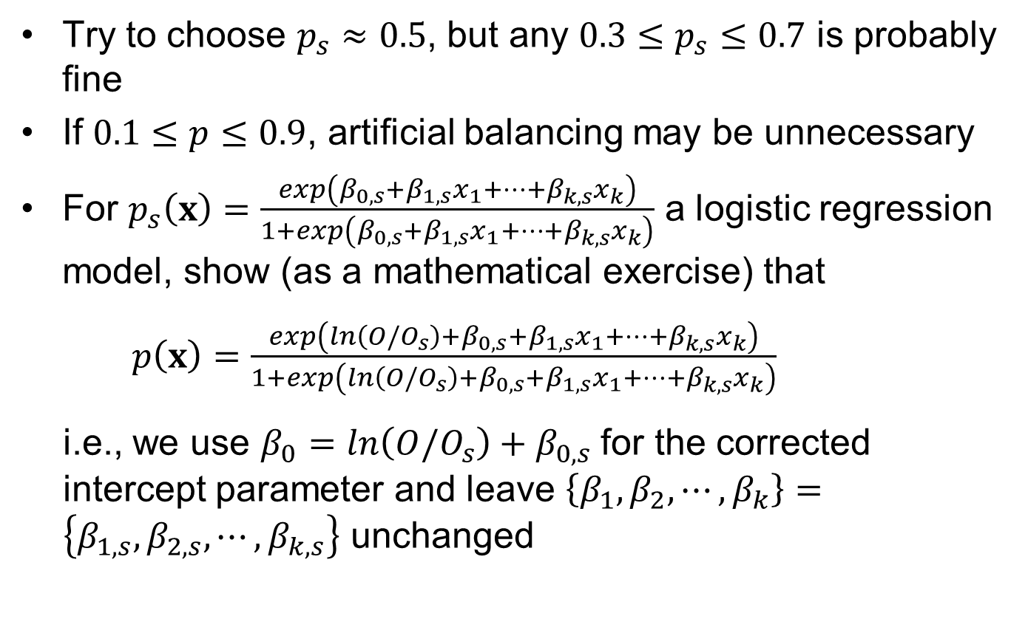
Discussion Points and Questions
Try to choose $p_{s}≈0.5$, but any $0.3≤p_{s}≤0.7$ is probably fine
If $0.1≤p≤0.9$, artificial balancing may be unnecessary
For $p_{s}\left(x\right)=\frac{exp\left(β_{0,s}+β_{1,s}x_{1}+⋯+β_{k,s}x_{k}\right)}{1+exp\left(β_{0,s}+β_{1,s}x_{1}+⋯+β_{k,s}x_{k}\right)}$ a logistic regression model, show (as a mathematical exercise) that
$p\left(x\right)=\frac{exp\left(ln\left(O/O_{s}\right)+β_{0,s}+β_{1,s}x_{1}+⋯+β_{k,s}x_{k}\right)}{1+exp\left(ln\left(O/O_{s}\right)+β_{0,s}+β_{1,s}x_{1}+⋯+β_{k,s}x_{k}\right)}$
i.e., we use $β_{0}=ln\left(O/O_{s}\right)+β_{0,s}$ for the corrected intercept parameter and leave $\left\{β_{1},β_{2},⋯,β_{k}\right\}=\left\{β_{1,s},β_{2,s},⋯,β_{k,s}\right\}$ unchanged

